Slide 1

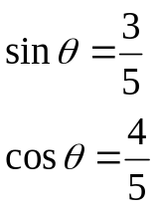

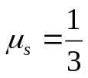




ES2501: Introduction to Static Systems
Quiz #2
(Equilibrium of particles)
Name:__________
The block of M=5kg, modeled as a particle, rests on the inclined surface that makes an angle of θ with the horizontal ground. The static friction coefficient between the block and the surface is μ_{s}=1/3. A force of P is horizontally applied on the block. Take g=10m/s/s for convenience.
Q1. Draw a free-body diagram (FBD) of the block.
Q2. Write down Cartesian vector expressions for all forces shown on your FBD with respect to the specified coordinate system shown..
Q3. Write down the scalar component form of the equilibrium equations in the x- and y- directions.
Q4. Find the critical value of P such that the static friction force between the block and the surface is zero.
Q5. Find the range of P needed to keep the block to rest on the surface without sliding down or pushing up
(Hint: The block could slide down for a significantly heavy block or be push up if P is too big)

